Slide 1
Infrastructure Engineering Orientation level

Slide 2
IEO – week 1

Slide 3
Teacher
Mr. Mikaeil Shaghelani Lor
Abbreviation: shln
Email: m.shaghelanilor@fontys.nl
Room: 2.39

Slide 4
Teacher
<Teacher’s name>
Abbreviation: <xx>
Email: @fontys.nl
Room: 2.xx

Slide 5
What is IEO?
Infrastructure engineering Orientation is a mandatory course for all first semester students.
This course has a follow up of IEA (Infrastructure Engineering Advanced) that is for students who want to select ICT & Infrastructure for their study profile.

Slide 6


Why?
As a student
You need this be
As a (young) professional
You’re expected to work ‘independently’
You’re expected to think critically
Notes:
You’re expected to work ‘independently’ != no team work!

Slide 7
Classes
Each week 4 academic hours at school
1 ~ 2 academic hour(s) of theory
2 ~ 3 academic hours of practical
See course description on Sharepoint
Time Calculation
Notes:
3EC = 3 * 7 = 21 -> 84 – 63 = 63 / 7 = 9 hours of home work

Slide 8
Way of working
Theory to support practical
Practical working in pairs
Assignment delivery on canvas and/or Git with deadline
Plagiarism == fail
Assessment weeks (week 6 and 12)
Absence on assessment week == fail
Missing classes is your own responsibility!

Slide 9
Theory classes
Week | Topics | Week | Topics
1 | Introduction to infrastructure & Computer's architecture | 7 | Network Layers (TCP/IP ) and Network Device
2 | Numeric systems (Decimal, Binary, Hexadecimal) | 8 | Internet Protocol, Addressing, Subnet Classful and CIDR notations
3 | Memory and negative numbers | 9 | Maintenance and drawing of the infrastructure
4 | Operating systems and Virtual machine | 10 | TCP and UPD protocols
5 | Version Control System GIT | 11 | Client/Server concept and IoT
6 | Assessment 1 | 12 | Assessment 2

Slide 10
Practical
Week | Assignment | Week | Assignment
1 | Research different generation of computers | 7 | Linux tutorial Wireshark – TCP/IP Packet investigation Netkit installation Create a Simple Netkit network
2 | Conversion of Numeric systems | 8 | Configure the lab based on requirements Exercise CIDR IP Addressing Access internet
3 | Conversion of negative numbers Research different memory type and usage | 9 | Create TCP/ UDP connection inside lab Investigate different TCP and UDP scenarios
4 | Linux installation using VM or dual boot Linux tutorial | 10 | Maintenance and drawing of the infrastructure
5 | Create git repository on FHICT server | 11 | Client/Server concept and IoT
6 | Assessment 1: Deliverables on canvas Git repository | 12 | Assessment 2: Deliverables on canvas Students demo of the network lab
Notes:
Note: both students must be present on the assessment day and show the working version of the lab to their teacher

Slide 11


Way of working
Notes:
No one way information delivery (Traditional classrooms) but more interactive working.

Slide 12


Way of working
?
Notes:
During theory you get an introduction to the topics
During practical it’s expected you read the practical documents and first try to figure how to do something with your pair & internet before asking the teacher.
No direct instruction (without trying yourself before) from the teacher.
Teacher will give feedback on pair process.

Slide 13
How to pass?
The grading
if (week6 == Pass && week12 == Pass && plagiarism == false)
{
Pair pass;
}
else
{
Pair fail;
}
See course description for more information.

Slide 14

Questions?
Notes:
For more information check the course description.

Slide 15
Hardware & how it works
Notes:
This part gives you a general idea of how a computer and its hardware works.

Slide 16
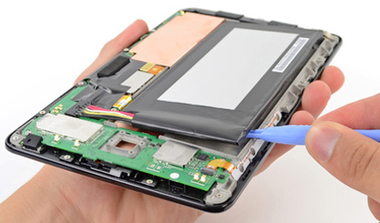
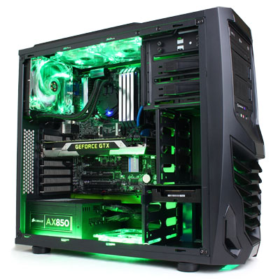
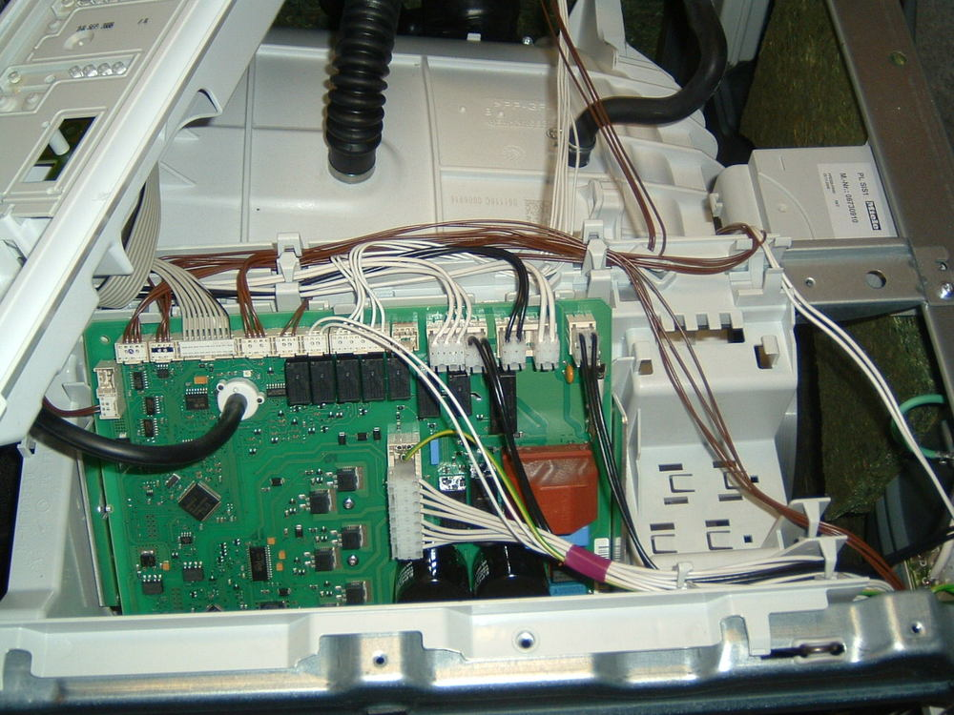
Hardware
Notes:
Top left: Tablet (Nexus 7)
Middle right: Game PC
Bottom left: Washmachine
These can all be seen as computer and they all have some similar hardware components

Slide 17
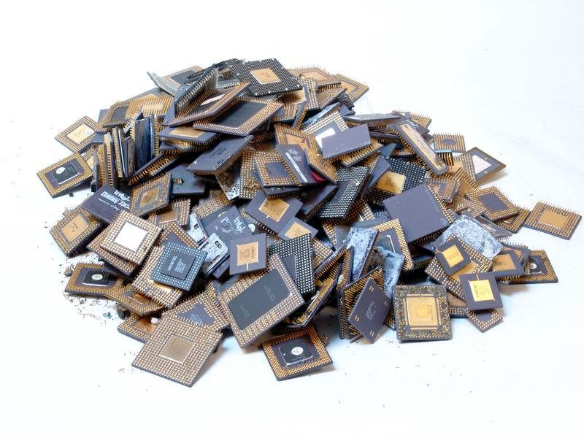
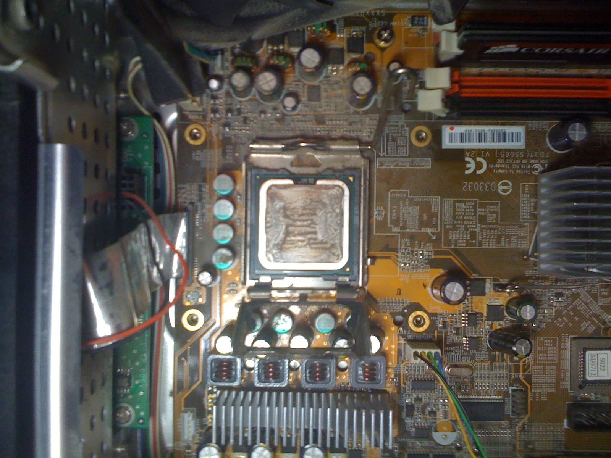
CPU
Central Processor Unit
‘Brain’ of a device
Executes small sets of instructions
Clock frequency (Hz or GHz (10⁹ Hz)
Notes:
Most important part of a computer is the CPU
It’s basicly the brain of the computer doing all calcualtions for us.
These calculations are actually instructions like add two values to each other or move data from one place to another.
How fast these instruction handled is dependend the CPU is. This speed is also called clock frequency and expressed in hertz (hz).
1 Hz means 1 instruction per second. Nowadays the CPU’s are fast and especcially th CPU’s in our PC its expressed om giga hertz (GHz).
1 GHz is the same is 1000000000 Hz
If you look at the image you see that the CPU is placed in a special socket on a circuit board. We will cover this circuit board later in the lesson.

Slide 18
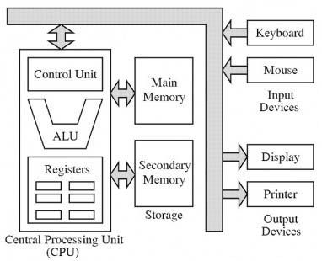
How does a CPU work
Notes:
If you look at the CPU itselsf we can see they generally exists out of a few parts:
· Control Unit: direct operations of the CPU; It tells the memory, ALU and I/O components how to respond to the instructions
· ALU: Arithmetic logic unit – a piece of circuit that arithmetic and logical operations; basically it’s the part of a CPU that actually does the instructions
· Registers: place where data is temporary stored for the ALU to process.
· NOTE: MMU is also part of modern CPU in a PC but it’s not shown here! The MMU stands for Memory management unit
This picture also shows von Neumann architecture. This architecture describes what ‘components’ a computer has and how the flow of communication bewteen the parts are. All modern computers are based on the von Neumann architecture.
One of these parts is the memory. If our computer does not have memory it will not be able to function as the memory is used to store data.

Slide 19
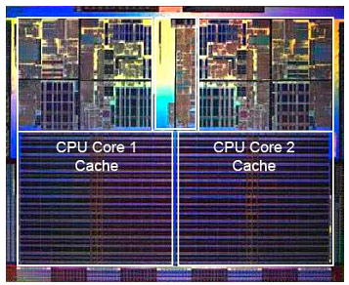
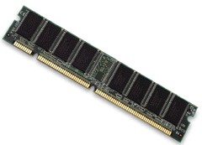
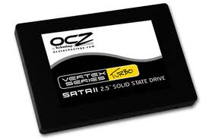
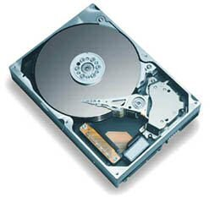
Memory types (1/2)
From fast to slow
CPU Cache
RAM
Solid State Disk
Hard Disk
Notes:
The main difference between these types of memory is basicly speed. The most left memory type (cache) is the most fast where as the most right (HDD) is the slowest.
The RAM falls into main memory and the two right are secondary memory/storage
The CPU Cache doens’t fall into the main memory category, but it does a similar task. It helps the CPU to temporary store (frequently used) data
So why not just have Cache memory? Its because of the cost and also where you can use it.

Slide 20
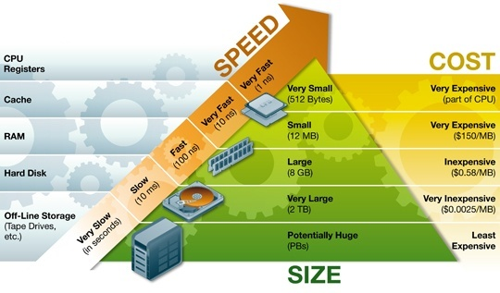
Memory types (2/2)
Why different types?
Notes:
Looking at this picture you get a general idea of speed, costs and size of the different types of memory

Slide 21
Besides CPU & memory
Notes:
The other part we have are the input- and output devices.
Input device is how we interact with the computer
Output device is how the computer interacts with us

Slide 22
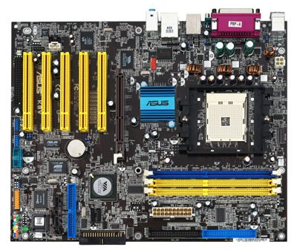

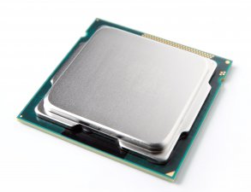
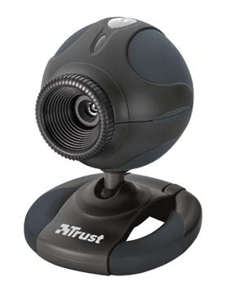
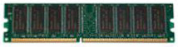
How does it work (1/2)?
Operating system
Notes:
So how does this all work with each other when there is input?
Input device recieves input and passes the data to the OS
OS passes the data with instructions tp the CPU
CPU processes the data and instruction and makes use of the memory

Slide 23
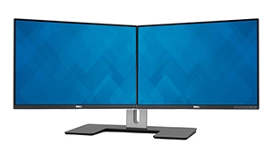
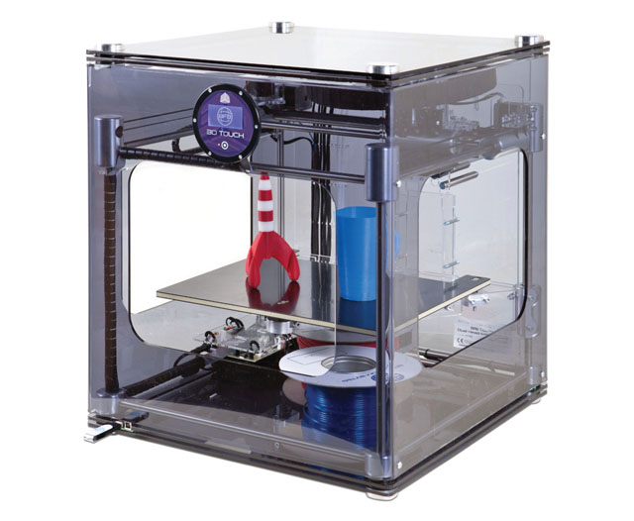
How does it work (2/2)?
Operating system
Notes:
So how does this all work with each other when there is output?
OS sends a instruction to the CPU
CPU processes the data and instruction by making use of the memory and passes the data back to the OS
OS passes the data to the output devices
Output devices ‘show’ the data

Slide 24
Last part
Notes:
Only one part of this image is left and it’s the gray arrows of the images. These arrows indicate the communication between the hardware components. These arrows are actually a printed circuis.

Slide 25
PCB
Printed Circuit Board
CPU Socket
Slots
Connectors
Ports
Etc…
‘Connects’ everything
Also: Motherboard
Notes:
A PCB has connectors/socket/ports each connected with circuits.
Slots: RAM, PCI-e, etc
Connectors: IDE, SATA, etc
Ports: Ethernet, Integrated sound, USB, etc
These circuits actually connects every piece of hardware to each other. This PCB is also called a motherboard

Slide 26
Questions?

Slide 27
A closer look at the processor
CPU (Central Processing Unit)

Slide 28
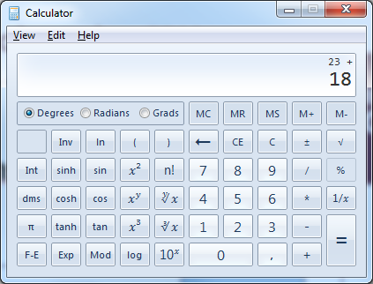
Closer look at the CPU
Handles set of small instructions
OS
Applications
CPU
Get number
23
18
23
18
Get number
Add numbers
Save result
41
41
program
in memory
data
in memory
Notes:
The CPU is actually handling small set of instructions it gets from the OS. Some examples: “move value from one memory location to another” or “add two numbers”
These instruction can be triggered from the OS or an application and are in binary. Next week we will cover binary.
In the above example we see ,in steps, what happens when we click = in a calculator adding 23 to 18.
Do take note that depending on the CPU type the instruction set are different. So instructions for a PC CPU will not work on I-Phone CPU
The speed these instructions are processed dependents on the processor speed (clock fequency). This means how many steps (not instructions) a CPU makes per second (measured in Hz or GHz (10⁹ Hz).
___________________________________________________________________
Background info: 1 CPU instruction exists out of multiple steps -> A CPU can handle multiple instructions in parallel if the instructions are in different steps.
For example: Instuction A – step: Decode & Instruction B – step: Fetch

Slide 29
CPU types
Why not just one type of CPU?
Not all CPU’s are equal in speed
Specific to task
Based on requirement: Processor speed, power usage, size, costs, etc
Some examples
Notes:
Up until now we treated all the CPU the same, but this is not the case. Look at all the different brands and devices they are in.
You will not find an Intel I-Core in a blu-ray player. Its overkill in processing power and will unnecessarily drive up the price of a blu-ray player.
Depending on the task and requiremnts of where the CPU is used the speed, power usage, size, costs etc. will be different.
Following sheets gives you some examples

Slide 30
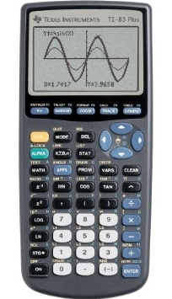
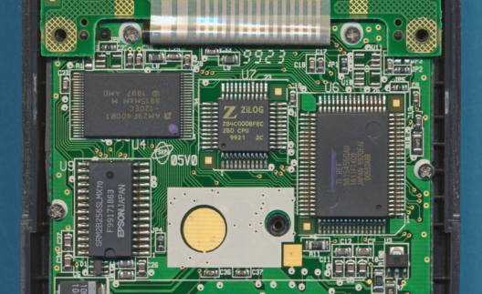
CPU - Calculator
Math calculations
Handles simple LCD display
Low power usage (small battery)
Notes:
More infor about the TI-83: http://www.datamath.org/Graphing/JPEG_TI-83PLUS_I0799.htm

Slide 31
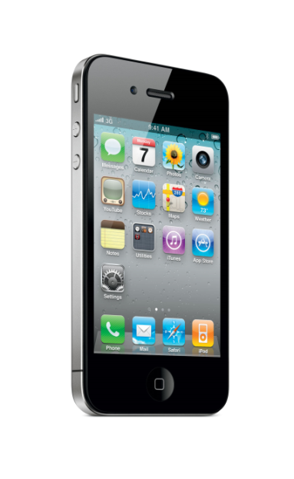
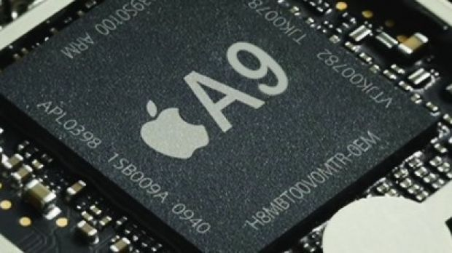
CPU - Mobile
Low power usage (battery)
Playing multimedia
3D Graphics
Small form factor
Notes:
The iPhone.
The CPU is part of a so called SoC (System on Chip) to reduce size and power usage

Slide 32
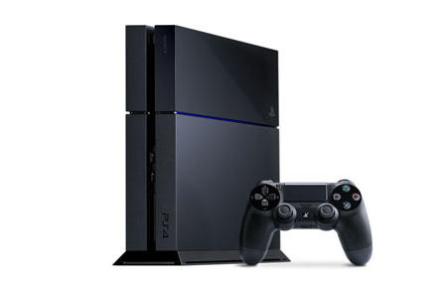
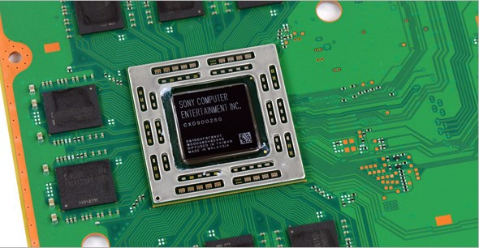
CPU - console
Graphic intense (3D)
Video playback
Notes:
PS4
Custom 8 core AMD Jaguar. Main concern is generating graphics for games

Slide 33
Video cards
GPU (Graphics Processing Unit)
Notes:
CPU can actually do ‘everything’, but when we look at graphics we usually have a dedicated piece of hardware to do this task.

Slide 34
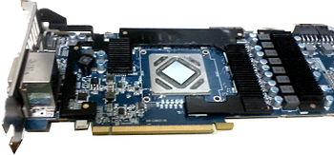
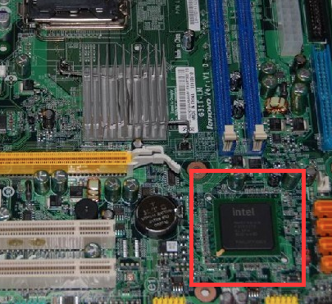
Video (graphics) Cards
An expansion card or integrated chip which generates a feed of output images to a display
Dedicated (external)
PCI Express slot
Integrated (Embedded)
Intel (most common in pc/laptop)
nVidia and AMD ATi (mobile dev.)

Slide 35
Usage (1)
Rapidly manipulate memory to accelerate the creation of images:
Animation
Gaming – PCs, mobile devices and gaming consoles
(3D) Design & special effects creation/editing
Visualizations in medical Instruments
And other purposes where fast rendering and high resolutions are needed

Slide 36
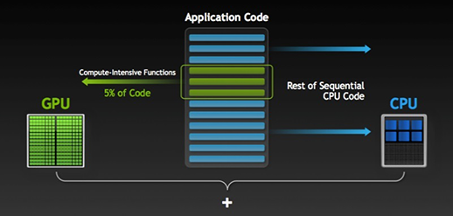
Usage (2)
GPU Accelerated Computing *
Use of a graphics processing unit (GPU) together with a CPU to accelerate applications.
A CPU consists of a few cores optimized for sequential serial processing while a GPU has a massively parallel architecture consisting of thousands of smaller cores designed for simultaneous tasks
Notes:
Ref: http://www.nvidia.com/object/what-is-gpu-computing.html
* This is a specific term from nVidia (API with c++), but other gpu manufacturers also offer similar functionalities

Slide 37
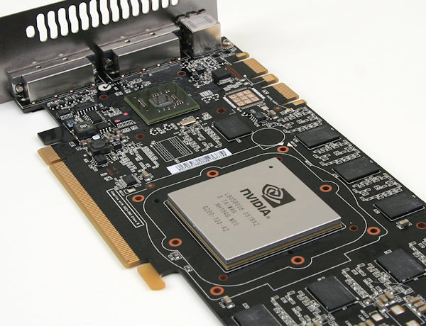
Video card components (1)
Graphics Processing Unit (GPU)
The main component that performs calculations for rendering and handles each pixel
Rapidly manipulate memory to accelerate the creation of images
> frame buffer
> to a display
Video Memory …
Output …

Slide 38
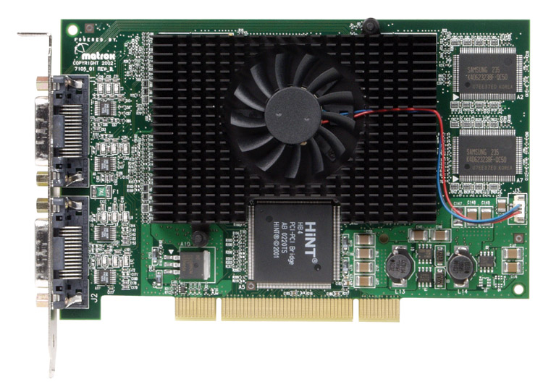
Video card components (2)
Video Memory
storing images and information about each pixel
GPU heat sink & fan
used for cooling
Circuitboard
MB Connection
BIOS
settings, information
overclocking*
Notes:
http://www.matrox.com/
MB Connection: Motherboard connection
BIOS (Basic Input/Out[ut
Bios can be altered for overclocking. Most high-end modern cards offer application that allows overclocking in one click

Slide 39
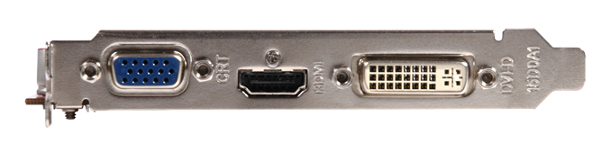
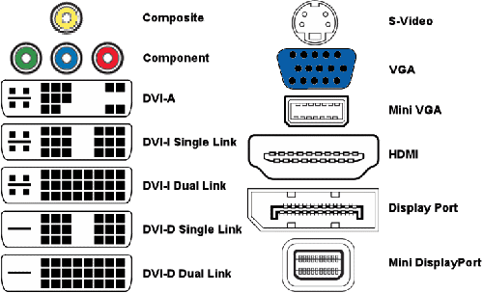
Video card components (3)
Output(s):
HDMI (audio* & video)
VGA (video)
DVI (Digital Visual Interface)
Display port
Video-in-video-out (ViVo) for tv/camera
Other …
Notes:
Certain HDMI older versions(or cables) do not transfer audio
Image ref: http://www.club-3d.com/index.php/news/message.en/items/low-power-consumption-high-value.html; http://www.pchardware.co.uk/graphiccards.php

Slide 40
How graphics cards work?
Take data from CPU and figure out what to do with each pixel to create image
GPU creates image, stores image with location and color of each pixel in memory
Memory also holds completed images until it’s time to display them (frame buffer)
Notes:
Pixel is one point/dot in an image

Slide 41

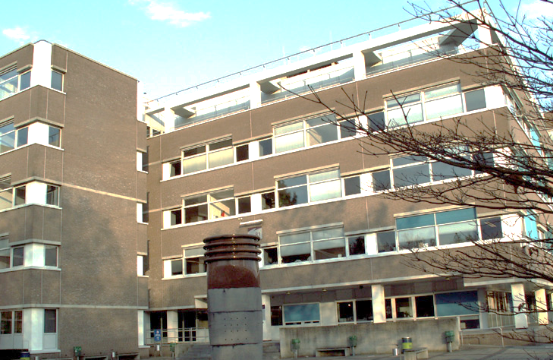
How is it displayed?
Image exists out of pixels
X pixels horizontal
Y pixels vertical
For example:
1920px horizontal
1080px vertical
1920 x 1080 is resolution of images
Notes:
pixel (picture element)

Slide 42
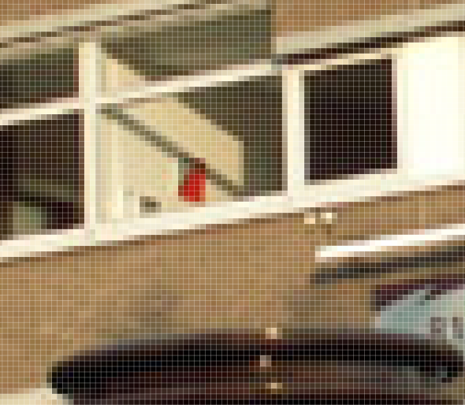
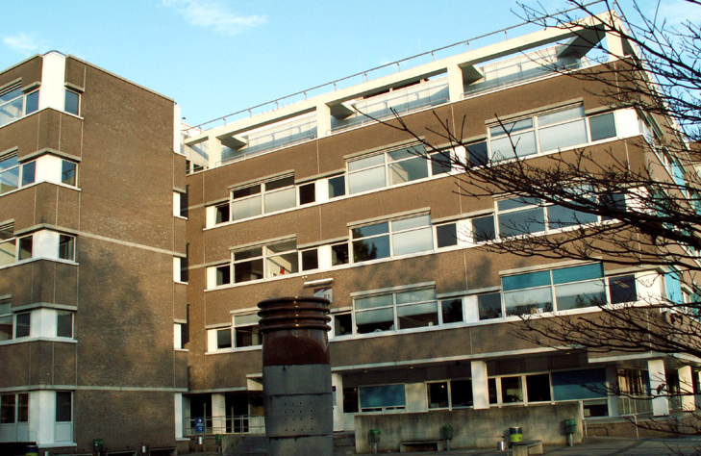
How is it displayed?
1 pixel represents a color
A color consist of 3 components
Red, Green & Blue (RGB)
Each component is represented with 8 bits (values 0 ~255):
255, 0, 0 is red
255, 255, 0 is yellow
128, 128, 128 is grey
Notes:
When you zoom in on an image
There are other ways to descibe a color besides RGB
HSL (Hue, Saturation, Luminace)
CMYK (Cyan, Magenta, Yellow, Key (key is black) )

Slide 43
Graphical modes
High Color (16 bits per pixel)
5 bits for Red, 6 for Green and 5 for Blue
Not optimal, but gives good results
Image with a resolution of 1920x1080
1920 x 1080 = 2073600 pixels
2073600 x 16 bits = 33177600 bits = 33.1776 Mb in video memory
True Color (24 bits per pixel)
8 bits for each RGB color
Sometimes 32 bits: 8 bits for transparency
Image with a resolution of 1920x1080
1920 x 1080 = 2073600 pixels
2073600 x 24 bits = 49766400 bits = 49.7664 Mb in video memory
Notes:
Why 6 bits for green? Green is usually chosen for the extra bit in 16 bits because the human eye has its highest sensitivity for green shades

Slide 44
Recap
Introduction to IEO
Basic Computer Architecture
Central processing unit
Graphical processing unit

Slide 45
Questions?

